Slide 1
MIND Study plots and tabulations

Slide 2
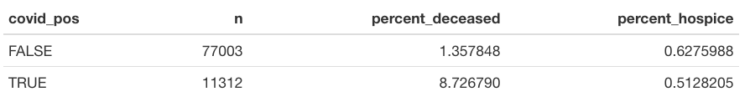
Overall mortality among covid and non-covid patients (ever vs never positive pcr test) – through 2/24

Slide 3
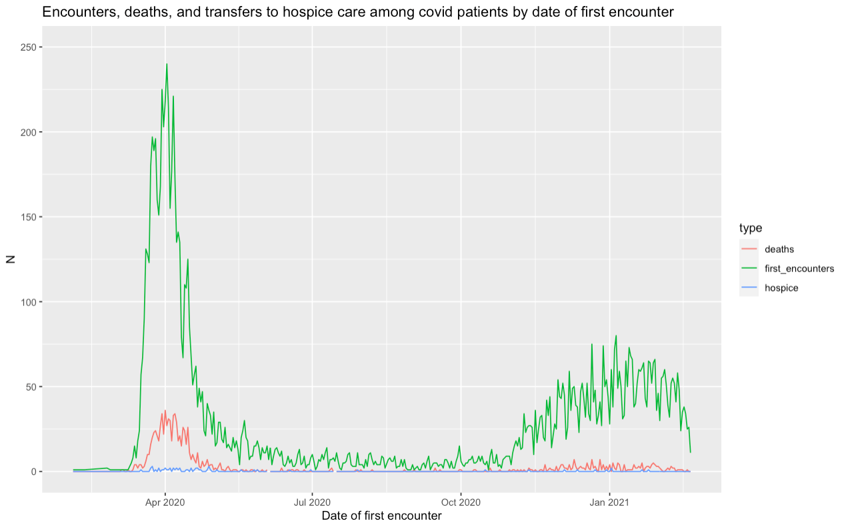

Slide 4
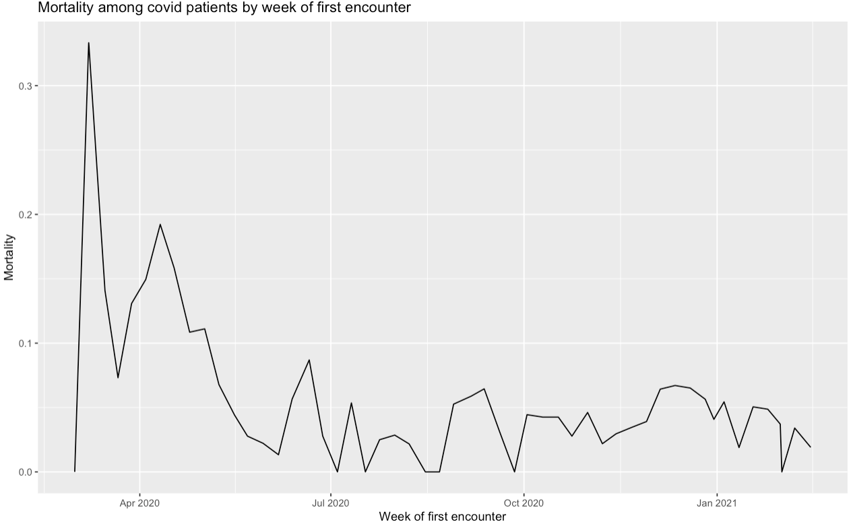
Notes:
(does not include transfers to hospice care)

Slide 5
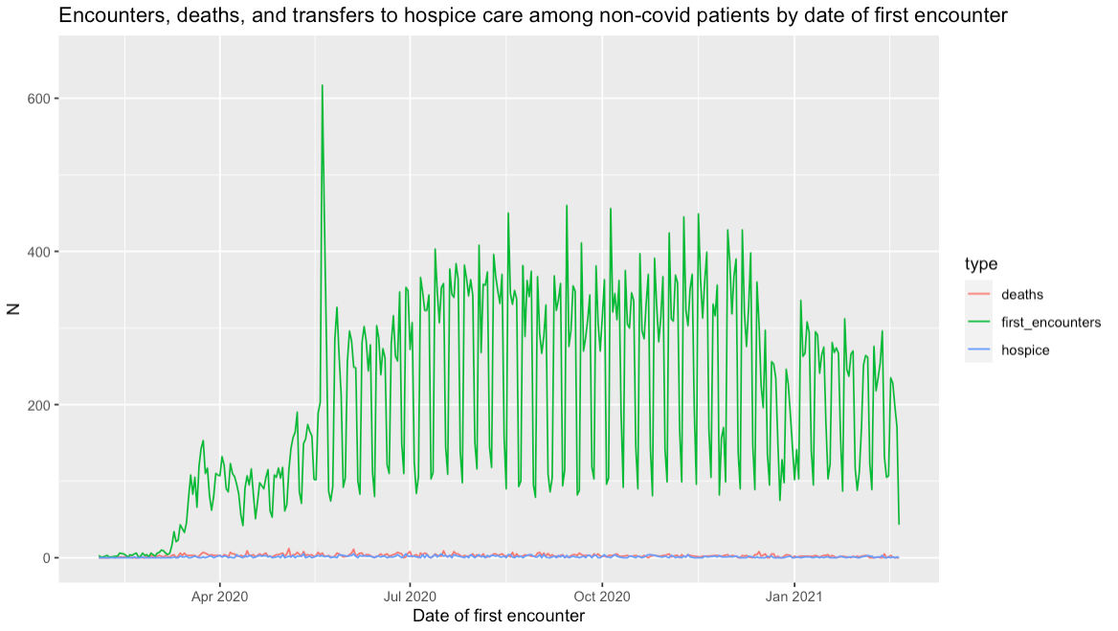
Notes:
If date was in the future, subtracted one year

Slide 6
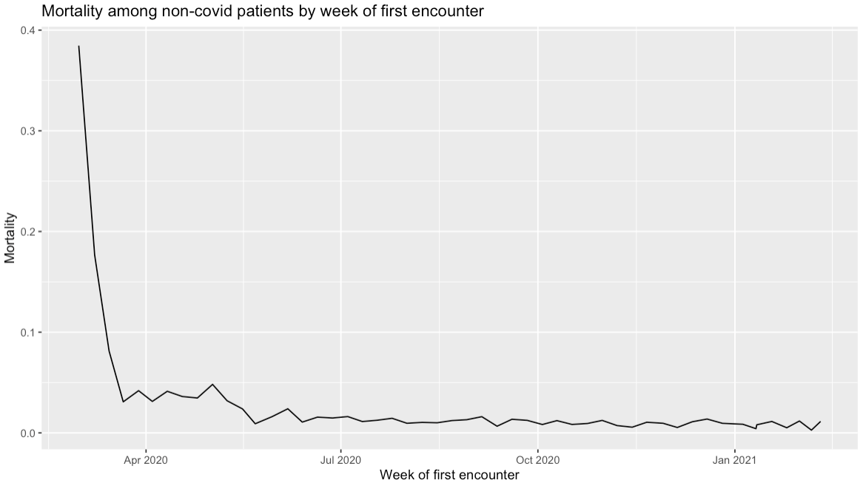
Notes:
(Does not include transfers to hospice care)

Slide 7
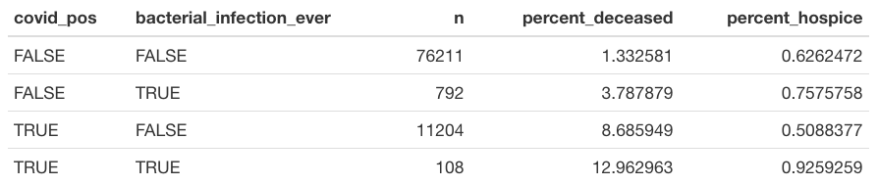
Overall mortality disaggregated by ever had a bacterial infection vs never had a bacterial infection, based on all specimens:

Slide 8
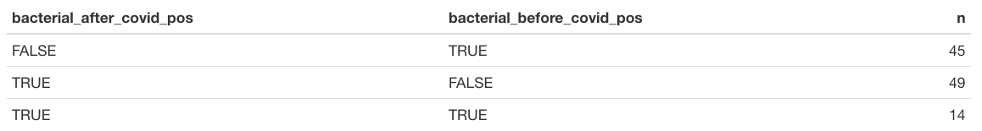
Did bacterial infections among covid patients take place before or after start of covid visits?

Slide 9
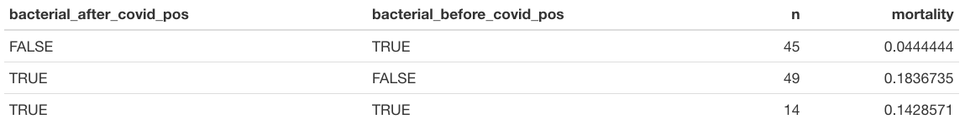

Slide 10
Tabulations on bacterial infections among covid patients to consider
When did they occur? Before during or after covid related stay? Was there a substantial population of people who had bacterial infections and subsequently got covid, or did most go covid then bacterial infection?
Blood confirmed vs other specimens
Compare mortality btw covid patients with in patient stays with and without bacterial infection
What kind of bacterial infection
Look at percent of covid patients who get bacterial infection over time

Slide 11
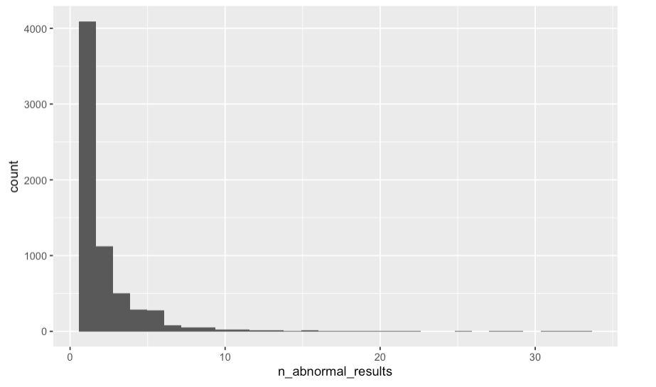
Number of abnormal results (number of instance, not number of organisms) per patient who ever had a bacterial infection – to get at patterns in testing
Notes:
Background exploration about testing for bacterial infections: Side questions that came up last time when we were talking about testing
Some overall questions about proportion of patients with bacterial infections – didn’t look into for now because we know we’re missing a whole bunch of info on them….

Slide 12
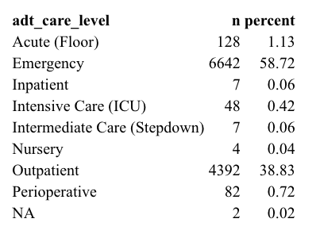
Background for “time in hospital” question How to define time in hospital?
ADT care level of first covid visit among
Patients who ever had a positive PCR
Notes:
Background for time in hospital for covid: how to define time in hospital?

Slide 13
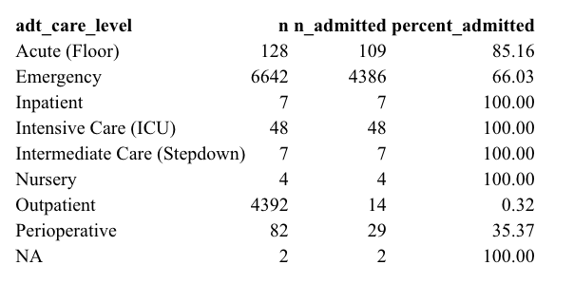
By adt care level of first covid visit, was the patient admitted in that same encounter?
Notes:
I haven’t yet looked into whether patients who were NOT admitted in that same encounter were then admitted subsequently. But, that might be of interest for outpatient and emergency visits, in particular.

Slide 14
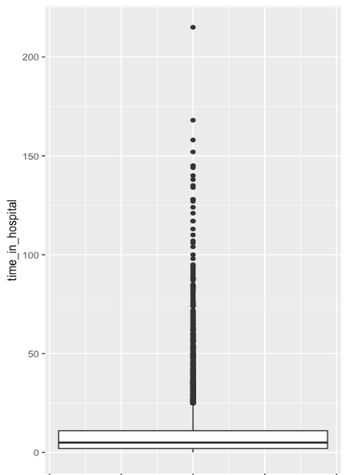
Time in hospital for those who were admitted during the first covid encounter (days between inpatient admission and discharge)
Notes:
Time in hospital: I assume we’re basically interested in the time in hospital of those patients who were admitted during that same “first covid visit”
Most are spending very little time, very few outliers are spending a lot of time.

Slide 15
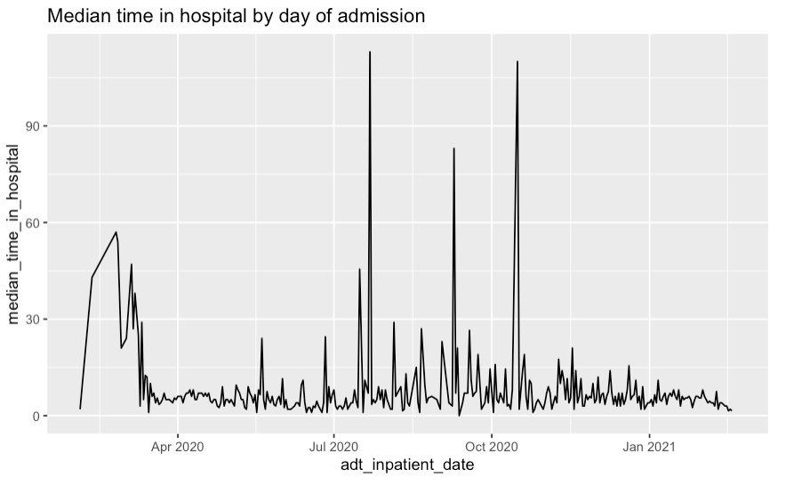
Notes:
(by date of inpatient admission)

Slide 16
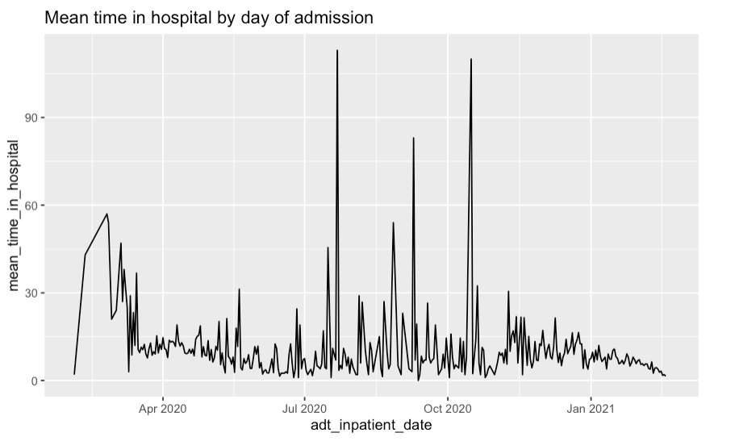

Slide 17
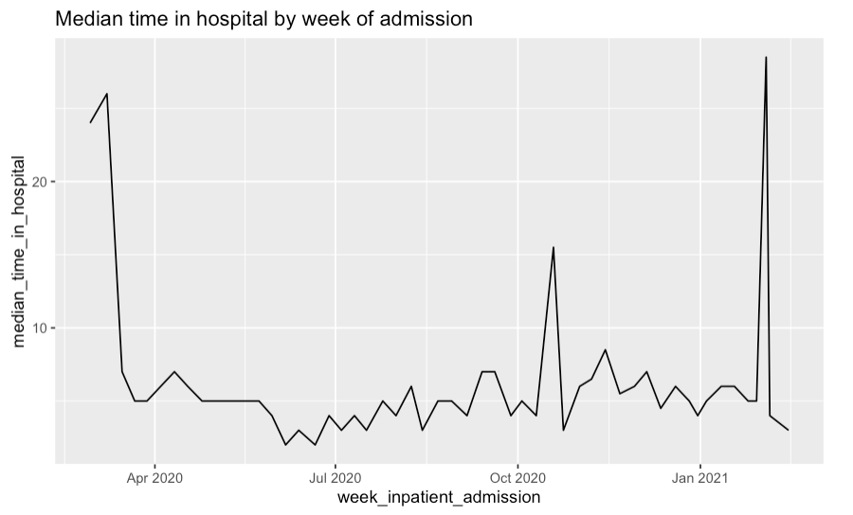

Slide 18
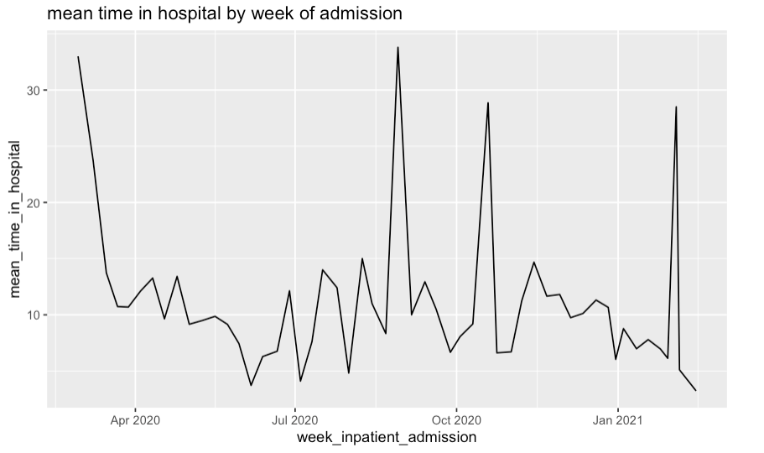

Slide 19

Present with covid → inpatient admission → discharge or death
admission rate mortality rate, time in hospital
Notes:
I have not yet looked at

Slide 20
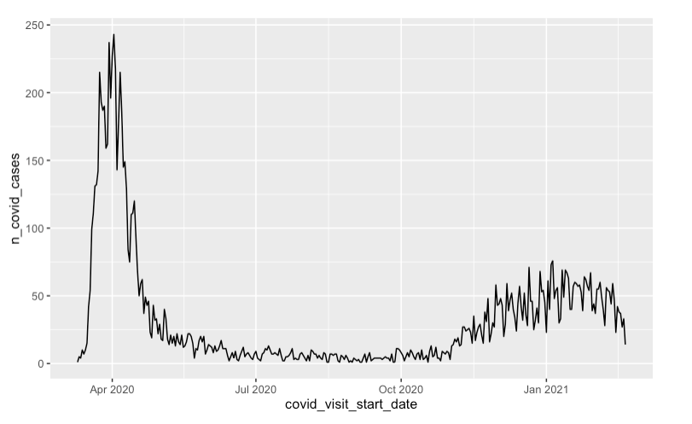
Covid positive PCR tests over time

Slide 21
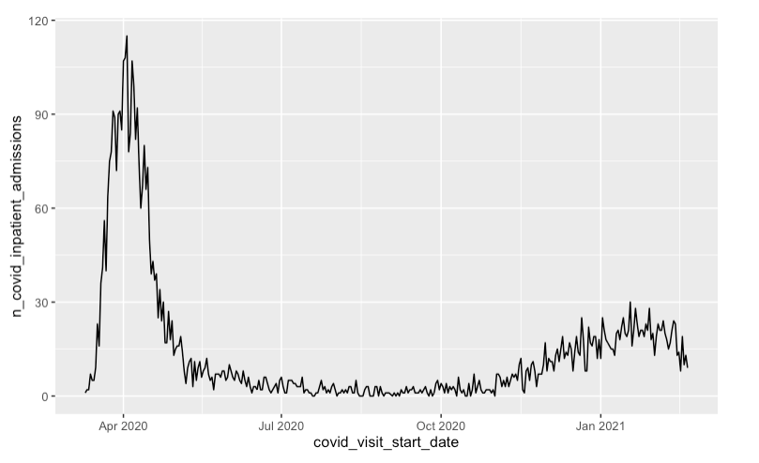
Covid inpatient admissions by date of first positive pcr test
Notes:
X axis is date of FIRST POSITIVE PCR TEST
I’d like to show you this over time, but this is what I’ve got so fart

Slide 22
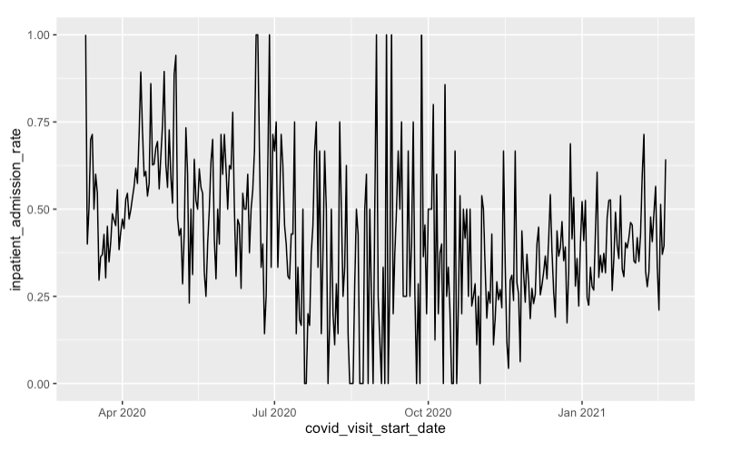
Admission Rate
Notes:
Decline: could have to do with care seeking being lower, or with improvements in management and treatment of covid, but doesn’t seem to have to do with

Slide 23
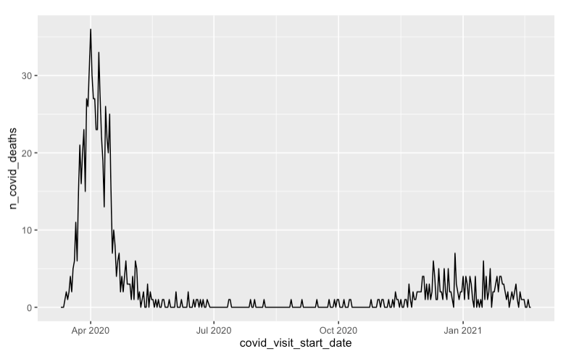

Slide 24
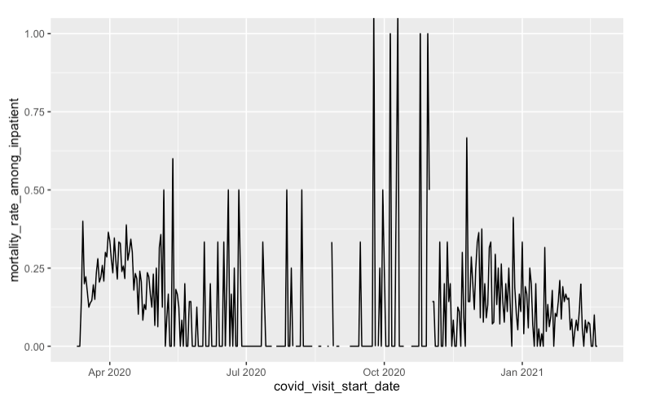
Mortality rate among inpatients with covid
Notes:
BY DATE OF FIRST POSITIVE PCR TEST

Slide 25
Questions about time in hospital:
Continue to look at time in hospital for covid patients?
How has time in hospital changed over time
What are predictors of time in hospital (consider bacterial infections)
Do we want to consider just the first admission for each patient, or all “covid admissions” based on the definition of an admission starting within 2 days prior – 7 days after first positive covid pcr test?
Time in hospital for patients with bacterial infections
Similar questions, look at covid as a predictor
Are we interested in total time in hospital, or time in hospital

Slide 26
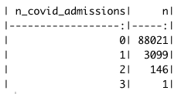
Various tabulations:
Number of covid admissions per patient among all patients in adt dataset:

Slide 27
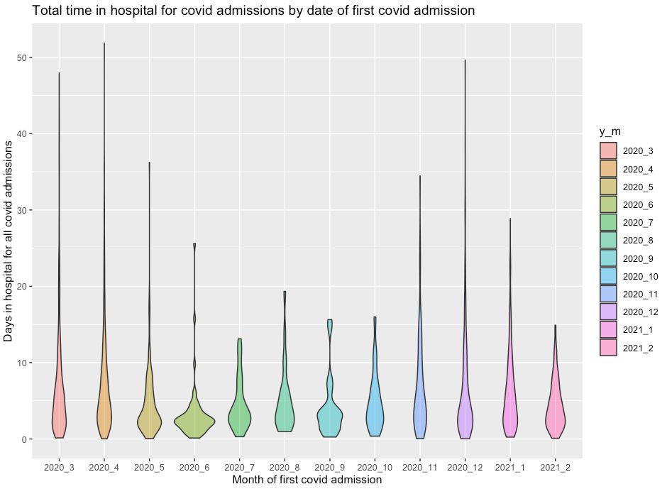
Notes:
Note: “covid admission” definitions will naturally exclude some subsequent admissions

Slide 28
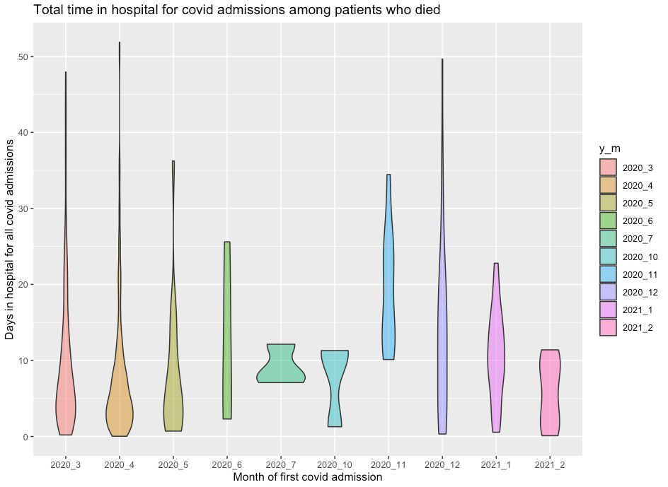
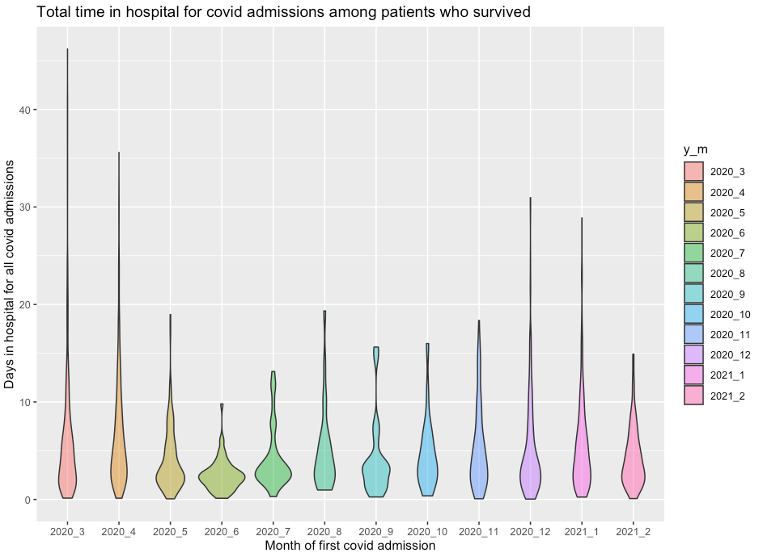
Disaggregated by deceased/not deceased
Notes:
Note: deceased and not deceased based on final outcome, NOT outcome after these two admissions, based on the information that we had about the patient.

Slide 29
Overview of available data in ADT, covid and micro datasets (by mrn) – As of February 2021 data update
ADT
91,265
Covid
112,106
72,972
0
20,805
18,293
0
36
7099
Micro
25,428

Slide 30
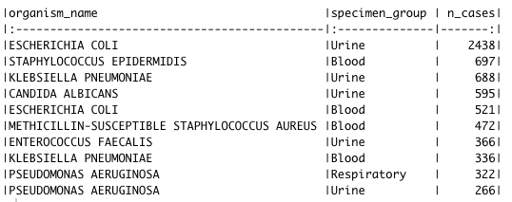
Most common organism – specimen combos
Notes:
What data do we have available for bacterial infections?

Slide 31
Outcome definition for “time in hospital” for bacterial infections

